Slide 2

We need to talk

Slide 3

Sometimes life invites us to work on things we didn’t intend to work on.

Slide 4
Burnout
3-dimensional construct of emotional exhaustion, depersonalization, and reduced personal accomplishment
59% of anesthesiologist report symptoms
Anesthesiology is a high-risk specialty for burnout
Directly linked to physician suicide

Slide 5
Burnout causes
Electronic health record
Increasing administrative burden
Increasing work hours
Diminishing work-life balance
Decreasing reimbursement
Increasing compliance/documentation
Workplace environment

Slide 6
Burnout outcomes
Decreased patient satisfaction
Decreased quality of care
Increase risk for major medical errors
Threatened patient safety
Diminished physician well-being
Increased cost of care—$4.6 B/year

Slide 7
Death by suicide
More than one physician dies by suicide each day
That equates to two graduating classes of medical students lost per year
This is more that 2x the general population
Likely underreported

Slide 8
Death by suicide
39% report major depression
20-40 x likely to have benzos
Strong connection between personal stress (depression) and professional stress (burnout)

Slide 9
Death by suicide
48% by firearms
23% by poisoning (>50% anesthesiologists)
14.5% by blunt trauma
14% by asphyxiation

Slide 10
Patients
More than a million patients lose their doctor to suicide each year

Slide 11
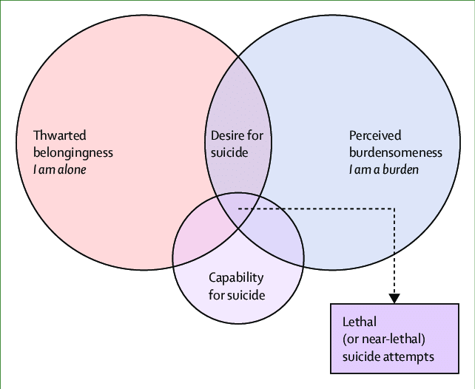
Interpersonal Theory of Suicide
Disconnection
Burden
Reduced fear of pain and death
Thomas Joiner, PhD

Slide 12

Disconnection
Unmoored from any purpose or value in continuing to live

Slide 13

We are predisposed
Nature
vs
Nurture

Slide 14

Modern Medicine is broken
and it breaking us

Slide 15

Loss of licensure
Fear of being reported
Shame
Perceived as weak
Resources

Slide 16

Beyond resiliency training
We have plenty of information, where we struggle is converting it into actionable knowledge

Slide 17

We need to build better boats

Slide 18

End the culture of silence
Fix the EHR
Change the state board licensing process
Create better access to resources
Rethink credentialing and privileging

Slide 19


Slide 20

Anesthesia Physician
Safety Foundation

Slide 21

Thank you

Slide 22
National Suicide Prevention Lifeline
1-800-273-TALK (8255)
Text “HOME” to 741741
Suicidepreventionlifeline.org

