Slide 1
“We are in trouble: Global carbon emissions reached a record high in 2018”
The Washington Post 12/6/18
“Tackling climate change could save millions of lives.” —WHO COP24 report 12/5/18
“Climate change threatens Americans’ health now…health care professionals are the trusted voices to educate the public.” --2018 Lancet Countdown on Health and Climate Change Brief for the US
Climate change is “humanity’s greatest threat in thousands of years” and the “collapse of our civilizations and the extinction of much of the natural world is on the horizon.”—Sir David Attenborough, British broadcaster and nature historian, addressing the UN Climate Change Summit on 12/3/18.

Slide 2
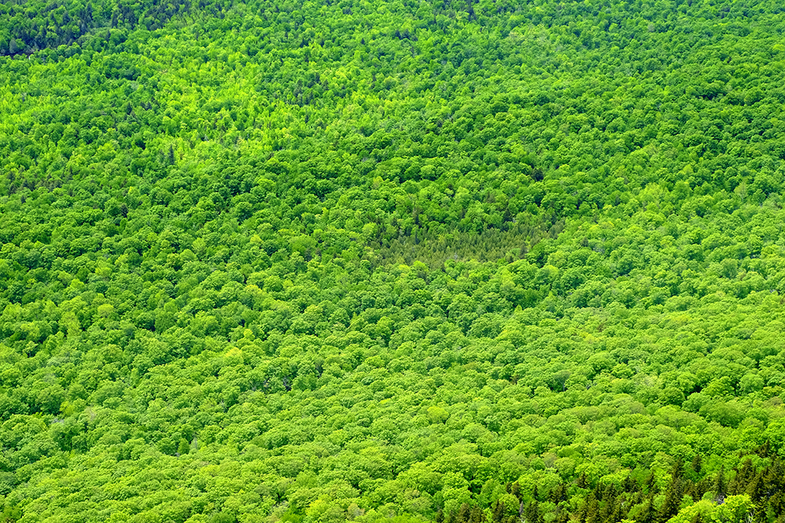
Plant 1.2 Trillion Trees

Slide 3
Molly Herr, MD
Pediatric Anesthesiology Consultant
Mayo Clinic
ASA Environmental Task Force
Mayo Clinic Enterprise Green Committee
Mayo Clinic Rochester Green Subcommittee
Mayo Clinic Rochester Blue Wrap Committee

Slide 4
It's Easy Being Green:
How Small Anesthetic Changes Can Make Big Environmental and Financial Impacts
Molly Herr, MD
Pediatric Anesthesiology Consultant
Mayo Clinic

Slide 5
Objectives
Briefly review the background on climate change
Highlight healthcare and anesthetic impacts on climate change
Examine a large academic institution’s anesthesia impact on the environment
Review a survey of anesthesia providers’ knowledge of anesthetic environmental impact and sustainability
Identify changes you can make to decrease anesthesia environmental impact while saving money

Slide 6
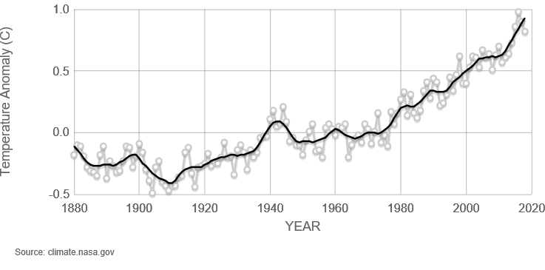
Change in global surface temperature relative to 1951-1980 average
18 of 19 warmest years occurred since 2001.
2016-hottest
2018-4th hottest

Slide 7
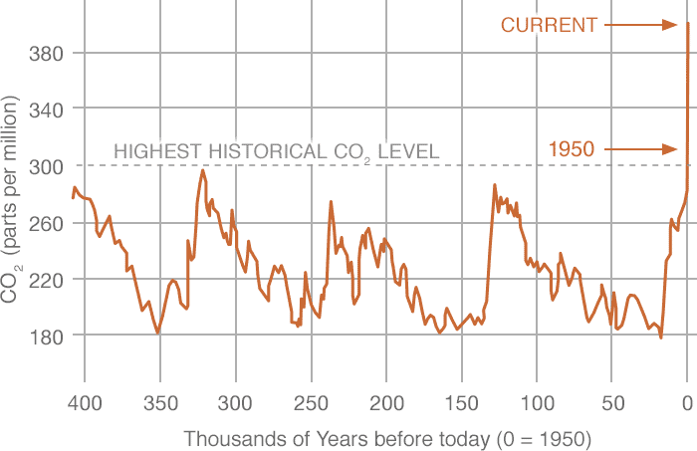
Ice core samples and recent direct CO2 measurements
414 ppm 4/28/19

Slide 8
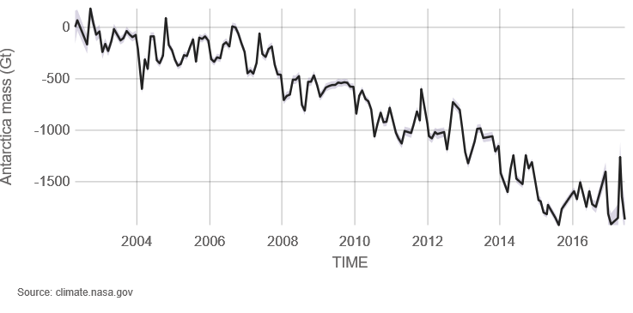
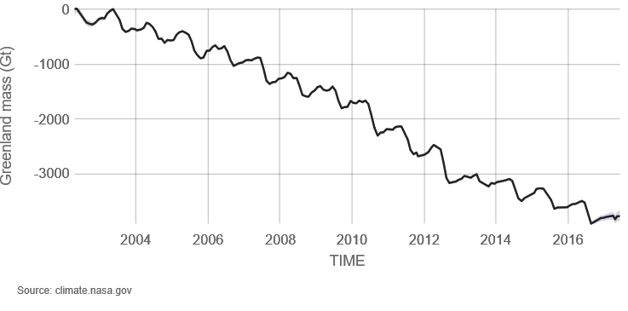
Ice Sheets losing mass; faster since 2009
Antarctica—lost 2000 gigatons
Losing 127 gigatons/yr (since 2002)
Greenland—lost 4000 gigatons
Losing 286 gigatons/yr (since 2002)

Slide 9
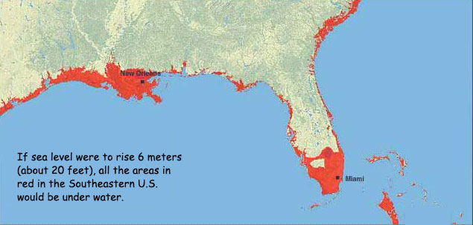
If the Greenland Ice Sheet melts….

Slide 10
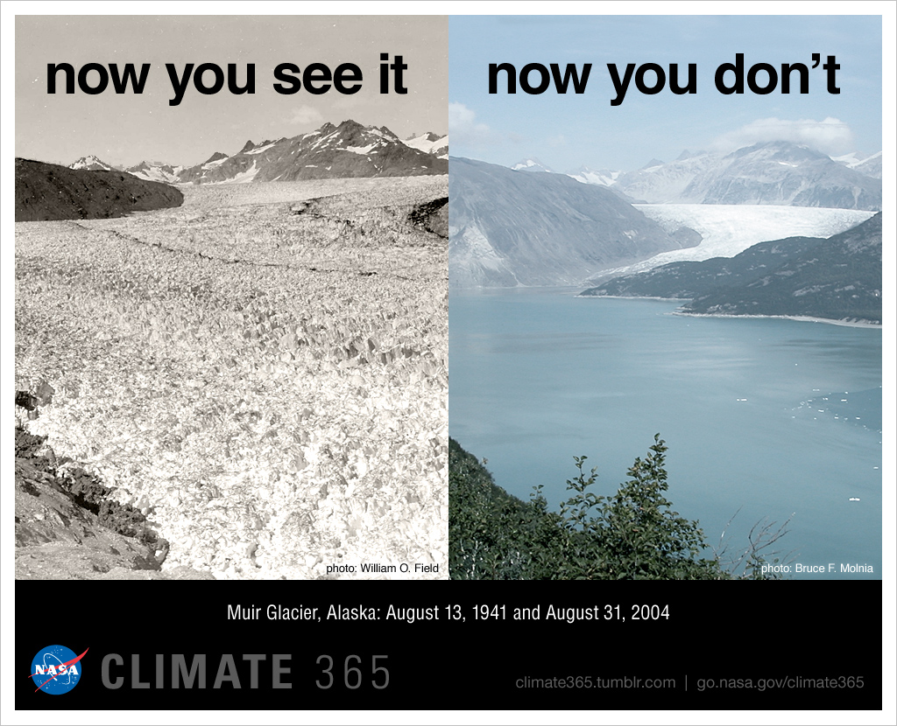

Slide 11
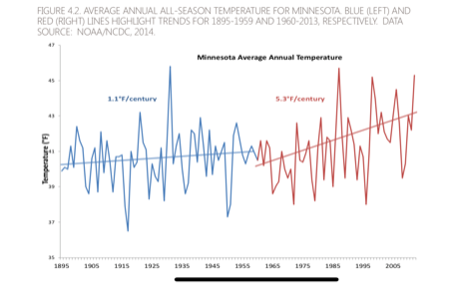
Minnesota Climate Change

Slide 12
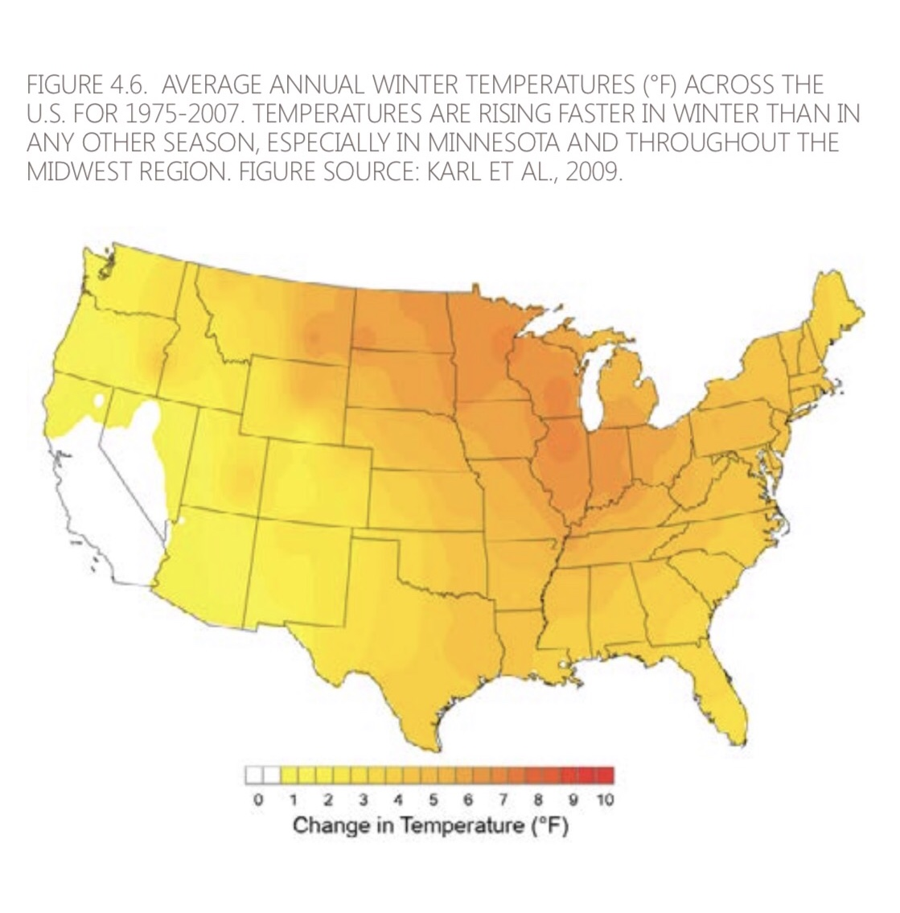
Minnesota Climate Change

Slide 13
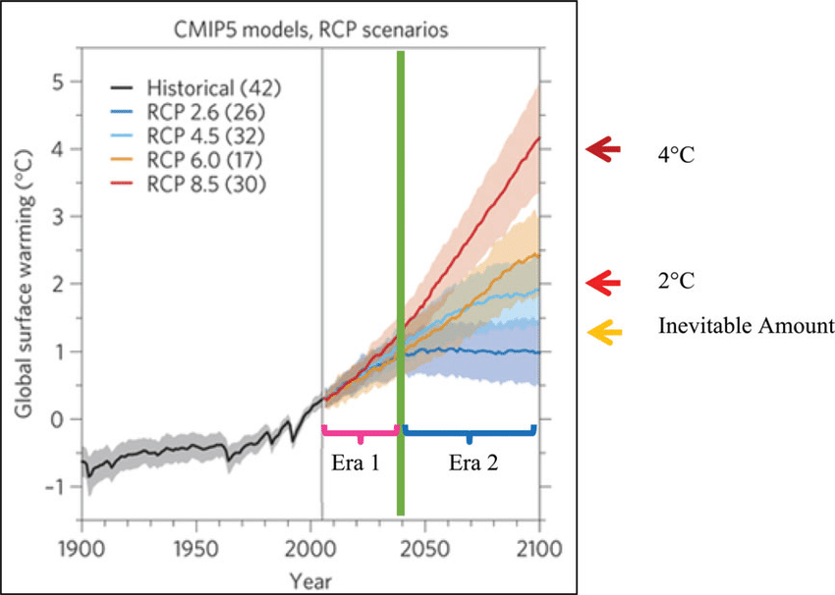
The Future: RCP—Representative Concentration Pathways
GHG concentration trajectories or models used by IPCC

Slide 14
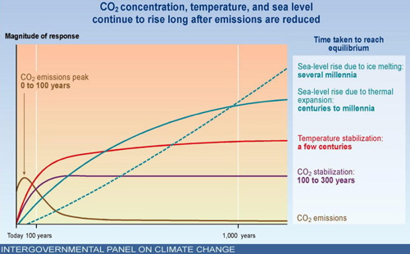
Lag times

Slide 15
Environmental Impacts of Climate Change
More extreme temperatures
Sea level increases
Stronger storms, hurricanes and storm surges
Increased precipitation and flooding
Increased drought and water scarcity
More frequent wildfires
Increased ozone concentrations and diminished air quality
Increased pollen and natural air pollutants
Increased range for disease vectors (mosquitos, ticks)

Slide 16
Health Impacts of Climate Change
Heat related illnesses, injury and mortality
Aggravation of existing conditions
Infectious diseases (Lyme, Zika, West Nile)
Water and food borne illnesses (cholera)
Mental health
Population displacement
Food insecurity, instability, and conflict

Slide 17
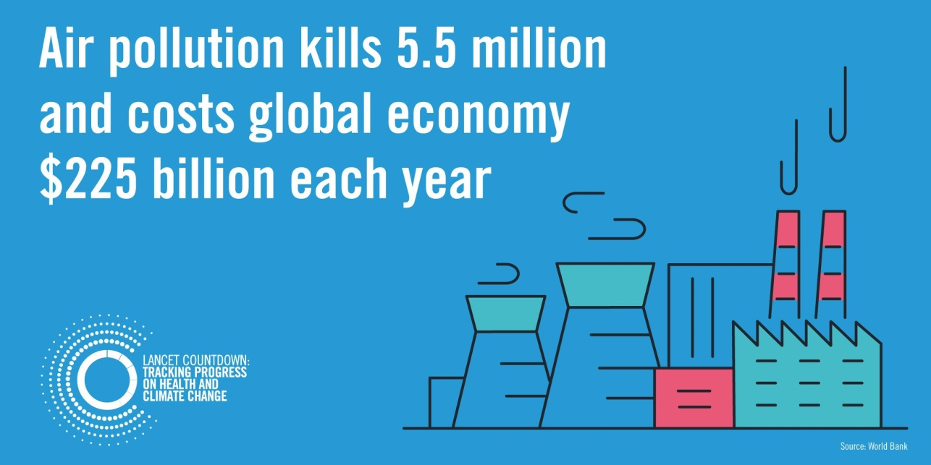
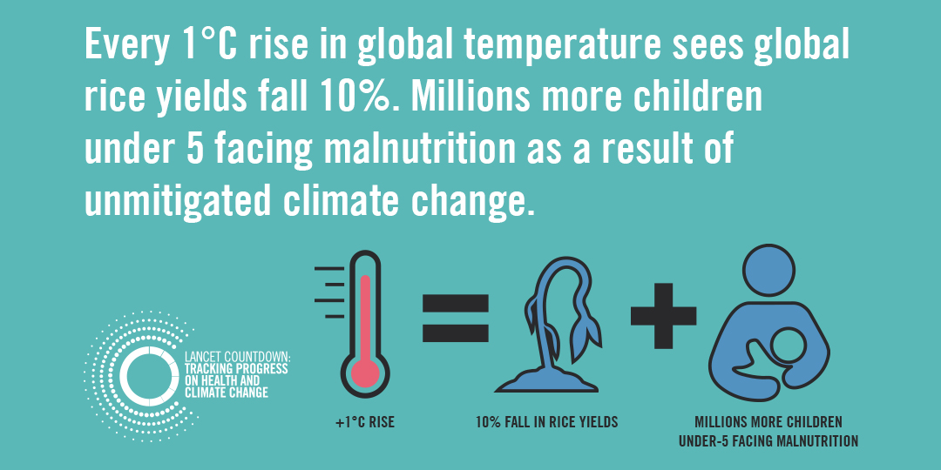
Lancet Countdown: tracking progress on health and climate change 2018
Independent, global monitoring of health and climate change.
Collaboration of 27 academic institutions, the UN, and intergovernmental agencies from all continents.

Slide 18
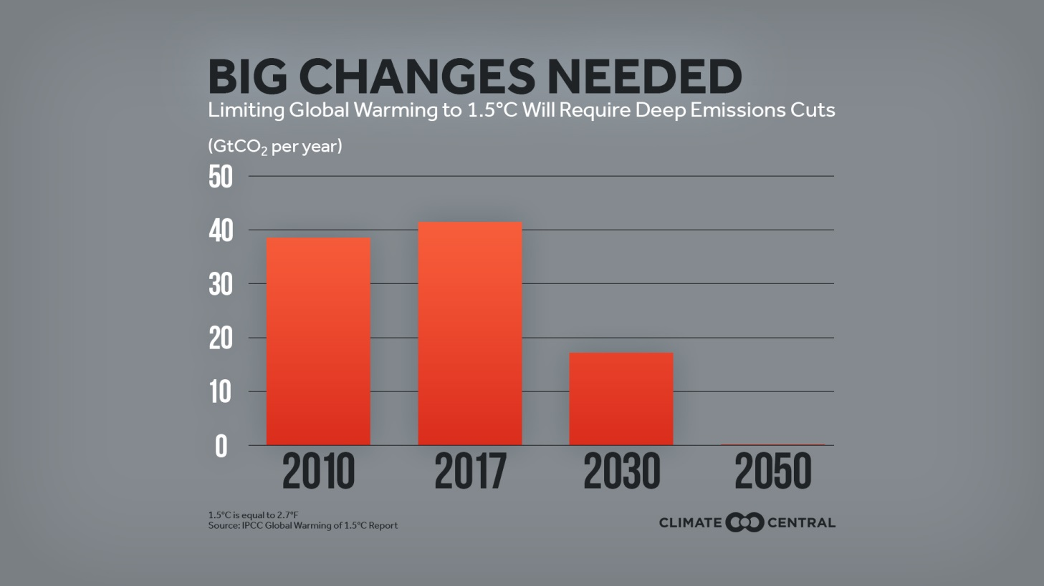

IPCC—Intergovernmental Panel on Climate Change
The United Nations body for assessing the science related to climate change
Created in 1988 by UN Environment & World Meteorological Organization, 195 member countries
Oct 2018

Slide 19

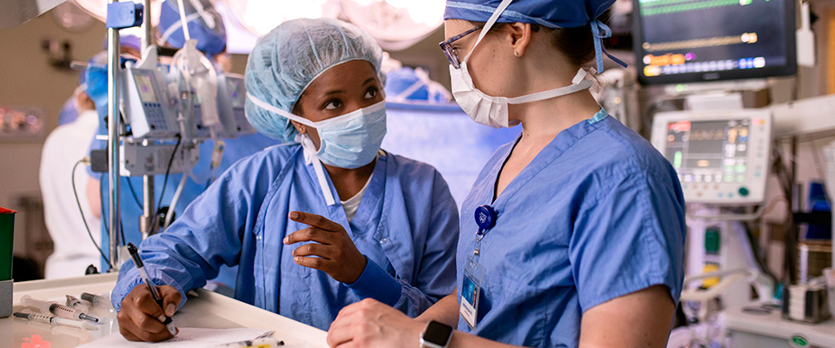
Healthcare and Anesthesia Impacts

Slide 20
Healthcare and Surgical Impacts on Climate Change
US Healthcare is responsible for 10% of US’s GHG emissions (1)
If the US healthcare sector was a country, it would rank 13th in the world (2)
ORs produce 25-30% of total hospital waste (3)
One routine surgery produces as much garbage as a family of 4 in one week (4)

Slide 21
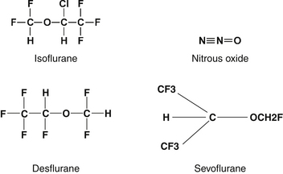


Anesthesia culprits

Slide 22
Anesthesia Gases
1 MAC inhaled agent at various FGFs | Atmospheric lifetime (yrs) | 100 yr Global Warming Potential (GWP) per kg compared to CO2 = 1 | Equivalent auto miles driven per hr use of anesthetic
Sevoflurane 2% 2L FGF | 1.1 | 130 | 8
Isoflurane 1.2% 2L FGF | 3.2 | 510 | 18
Isoflurane 1.2% 1L FGF |  |  | 9
Desflurane 6% 2 L FGF | 14 | 2540 | 400
Desflurane 6% 1 L FGF |  |  | 200
N2O 60% 1 L FGF | 114 | 298 | 61
Propofol nearly 10,000x less GHG emissions than volatiles; even with waste, tubing, electricity for pumps.

Slide 23
Fresh gas flow
Low flow matters
At maintenance, FGF < 1 L/min
Sevoflurane
  FDA—greater than 2 MAC hrs FGF = 2 L/min
  Less than 2 hrs FGF = 1 L/min
Pause FGF during intubation

Slide 24
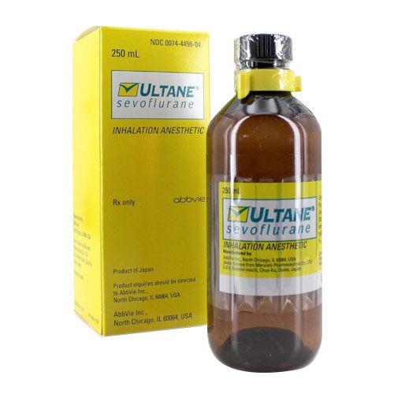
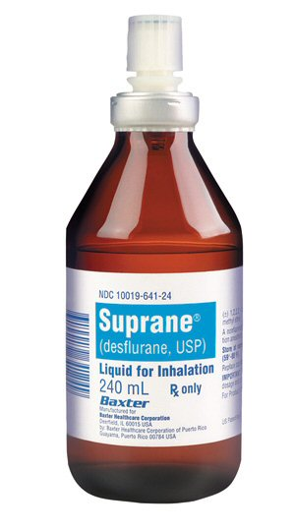
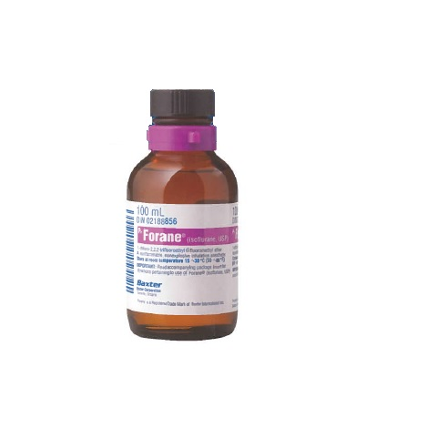
Volatiles
100ml
6 bottles = $ x
250ml
$ x
240ml
$ 2x

Slide 25
2017 Volatile/Nitrous oxide usage
Volatile | Bottles | mT volatile (metric ton= 1000 kg) | mT CO2e | Equivalent auto miles | Car equivalents (US car 22mpg—ave yearly use) | Department Cost in $
Desflurane | 5267 | 1.858 | 4719.52 | 11,500,000 | 958 | 10x
Isoflurane | 6594 | 0.989 | 504.44 | 1,225,000 | 102 | x
Sevoflurane | 4050 | 1.235 | 160.52 | 495,000 | 41 | 4x
Nitrous oxide | pounds | mT N20 | mT CO2e (metric ton= 1000 kg) | Equivalent auto miles | Car equivalents | Cost in $
N20 | 65,830 | 29.86 | 8899 | 21,750,000 | 1813 | x

Slide 26
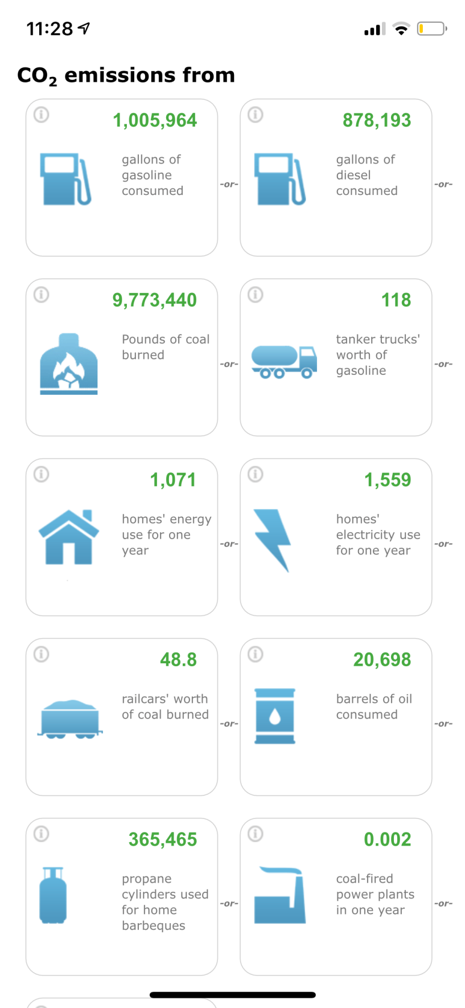
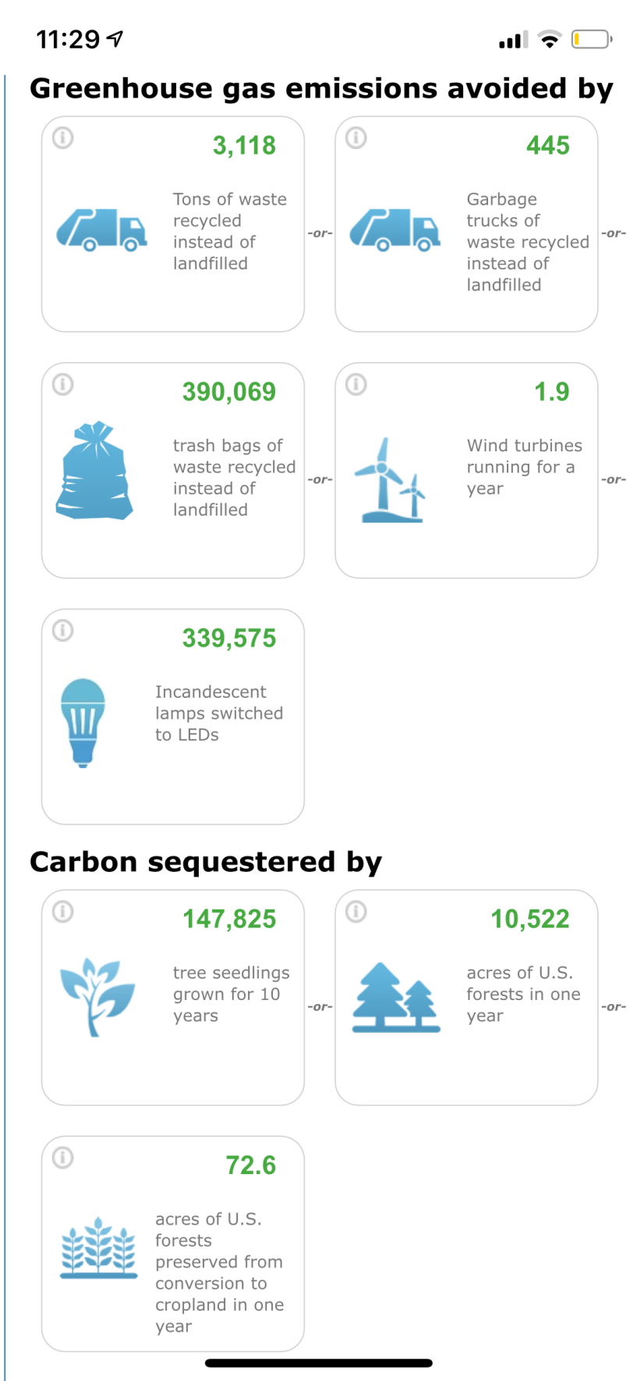

Slide 27
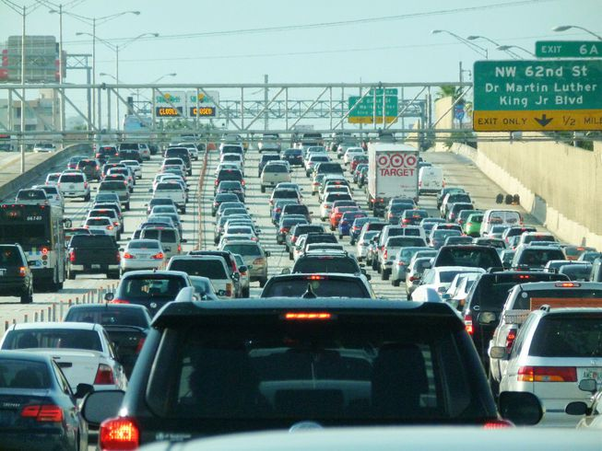

Slide 28
What do experts know about this?
Mayo Anesthesia Provider Survey
Focused on anesthesia environmental impact and sustainability
  Baseline knowledge assessment
  Attitudes
Residents, fellows, SRNAs, CRNAs and consultants in the Department of Anesthesiology
412 of 647 responded
63.7% response rate

Slide 29
Survey questions
Which volatile anesthetic is best/worst from environmental standpoint?
Which volatile is most/least expensive?
Recycling attitudes in general
Does cost/environmental impact affect your anesthetic choice?
Would knowing more about environmental impact on anesthetic agents change your practice?
Demographics of respondents

Slide 30
Results
Operating room waste: 20% correct
Worst volatile: 67% correct
Best volatile: 19% correct
Length of activity in atmosphere:
  52-55% responded as “don’t know”
  10-17% correct
Prices: 86-92% correct
Recycling at home:
  93.6% always or nearly always
  6.3% sometimes, rarely, or never

Slide 31
Results
Environmental impact affects plan:
  Always 1.7%
  Nearly always 5.6%
  Sometimes 34.5%
  Rarely 34.1%
  Never 24.1%
Cost affecting anesthetic plan
  Always 4.4%
  Nearly always 18.3%
  Sometimes 59.3%
  Rarely 13.4%
  Never 4.6%

Slide 32
Results
Would knowing more about environmental impact of anesthetic agents change your practice?
  Very likely to change 40.9%
  Somewhat likely 42.1%
  Neither likely nor unlikely 9.7%
  Somewhat unlikely to change 3.9%
  Very unlikely 3.4%
83%
7.3%

Slide 33
Conclusions
Knowledge gaps exist regarding volatile anesthetic environmental impact
Large majority recycle at home
Environmental impact plays a small factor in anesthetic choice
Knowing more about environmental impact of anesthetics would be very or somewhat likely to change anesthetic choices

Slide 34
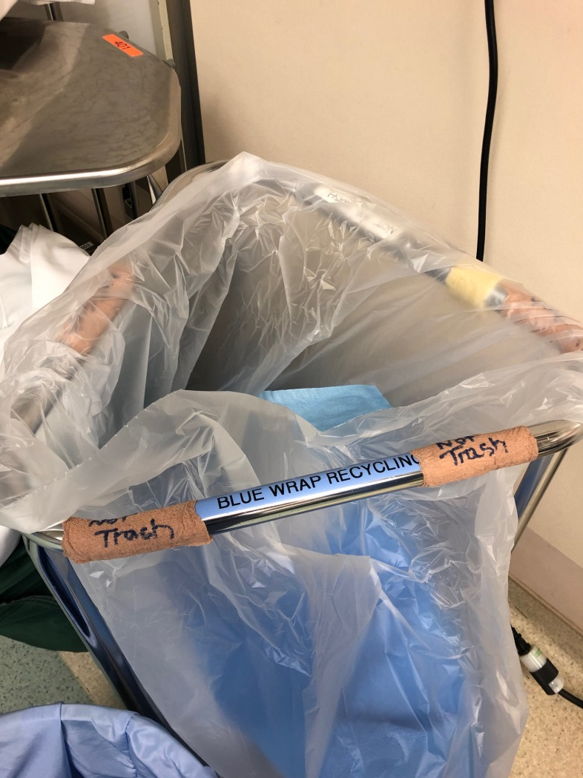
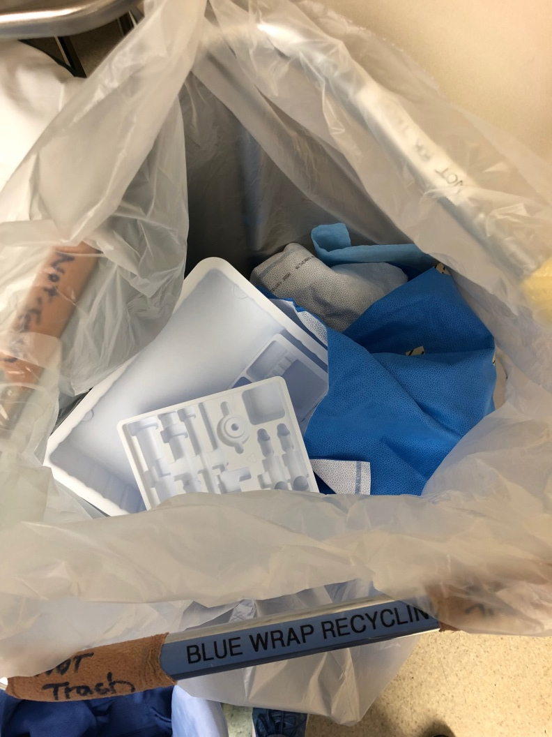
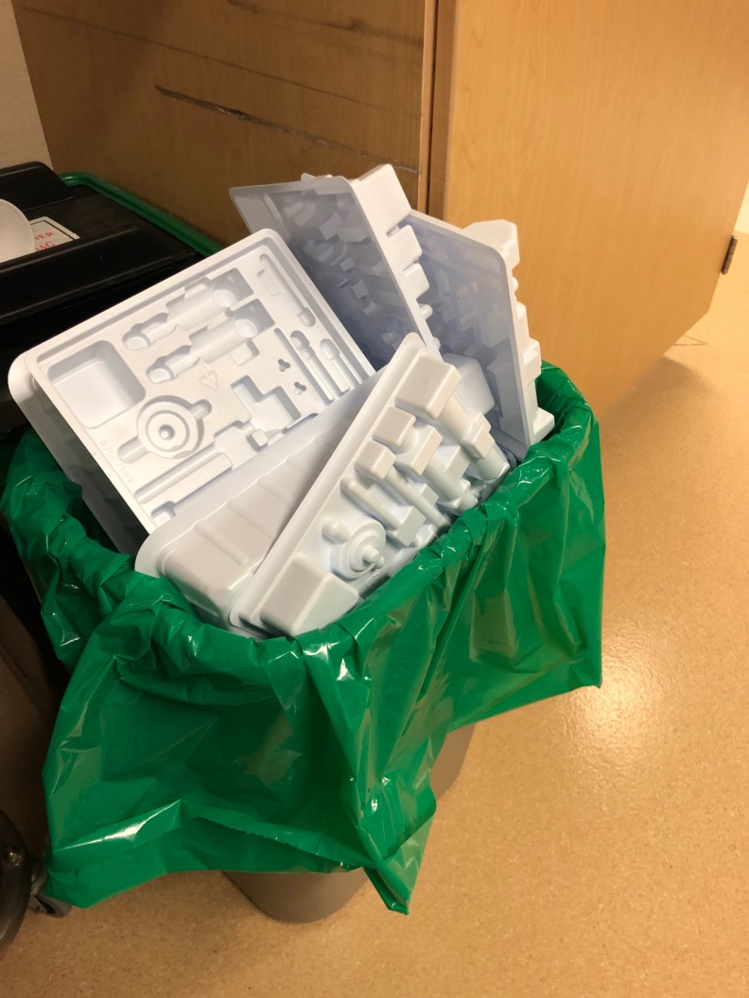
OR Blue Wrap and Medical Plastic Recycling

Slide 35

Other projects
Green Journal Pilot Project
Propofol waste reduction with a nomogram
Greener equipment
  Environmental Preferable Purchasing
  Laryngoscopes
  Circuits, masks without phthalates or plasticizers.

Slide 36
What you can do…
Avoid desflurane and nitrous oxide
Low FGF during maintenance
Stop gas flow while intubating
Consider propofol supplementation/TIVA
Consider regional techniques
Don’t open equipment until it’s needed

Slide 37
What you can do…
Investigate more environmentally friendly equipment
Limit medication waste (propofol, opioids)
Recycle pulse ox probes
Recycle blue wrap in the ORs
Recycle medical plastics
Get involved in a Green Committee
Form a Green Committee

Slide 38
Resources
Practice GreenHealth
CleanMed conference
Health Care Without Harm
The Medical Society Consortium on Climate and Health
MN Health Professionals for a Healthy Climate
Minnesota Department of Health
  Mn Climate and Health Program

Slide 39
Resources
www.CO2.earth
Minnesota Pollution Control Agency
CDC Environmental Public Health Tracking Network
Yale School of Public Health’s Climate Change and Health Certificate Program
EdX--The Health Effects on Climate Change by Harvard

Slide 40
Thank You
herr.molly@mayo.edu

